Slide 1

Data Science vs Artificial Intelligence
BY MXK

Slide 2
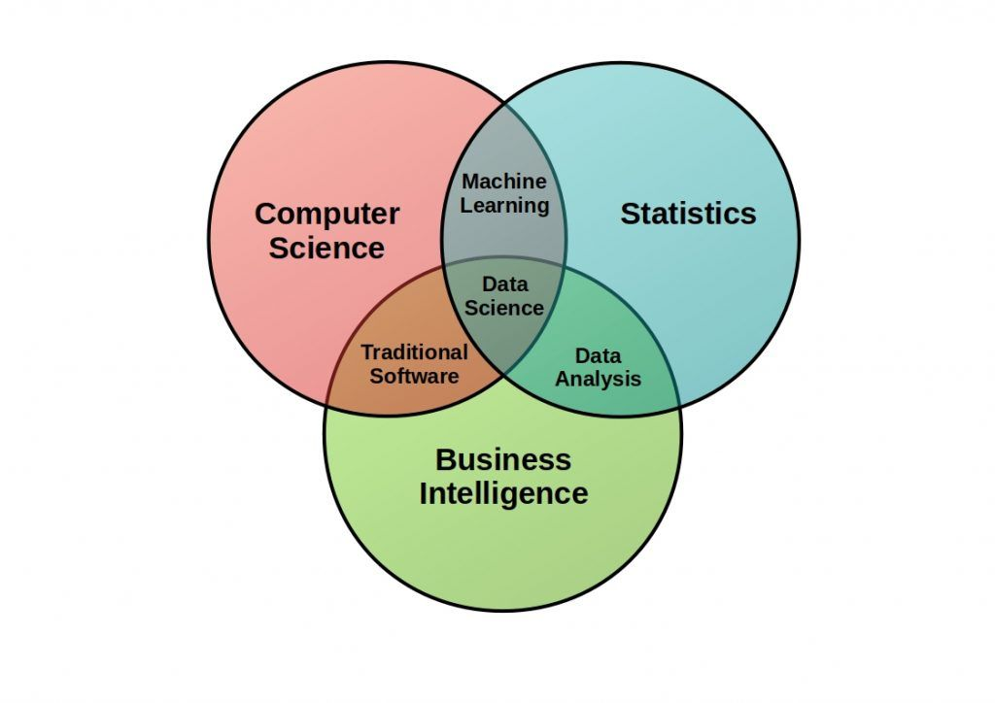

Slide 3
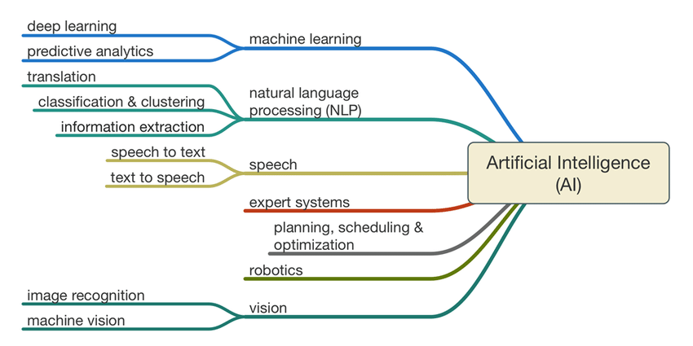

Slide 4
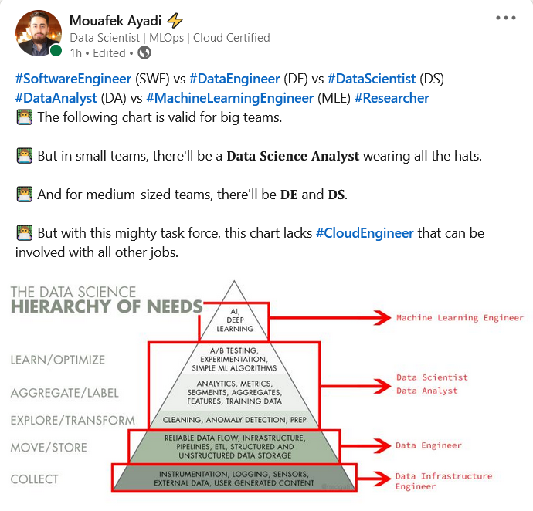

Slide 5
Thank You
Q & A

